Slide 1
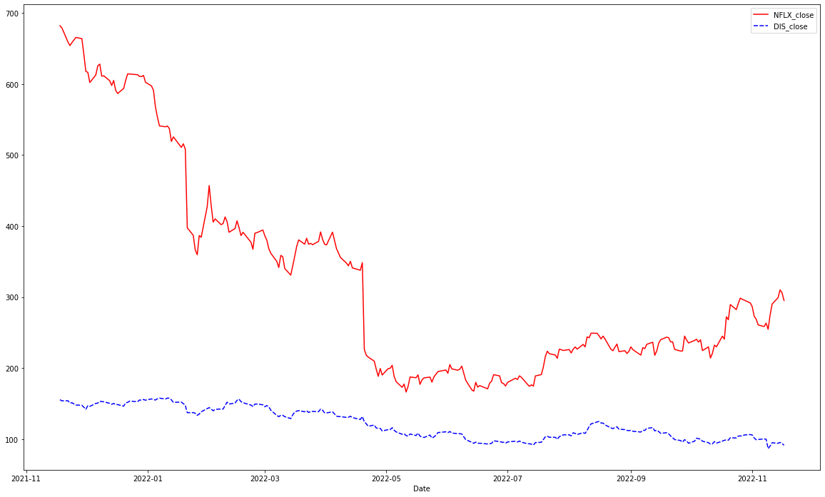
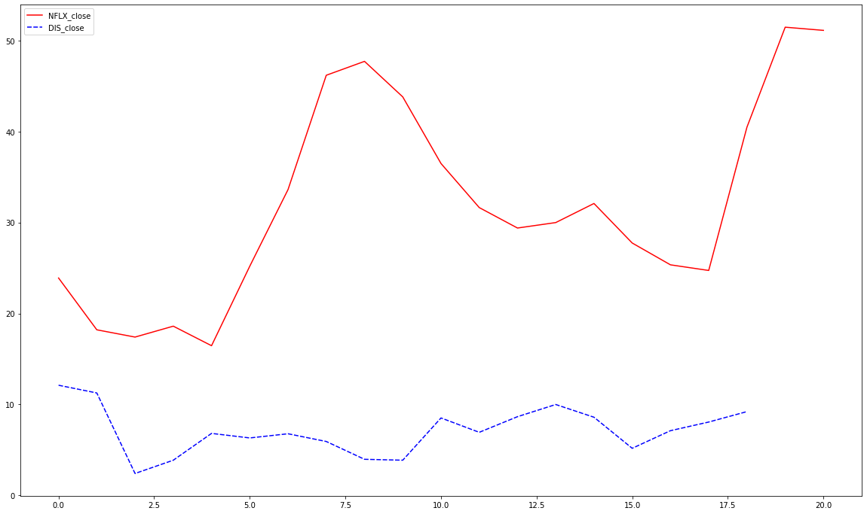
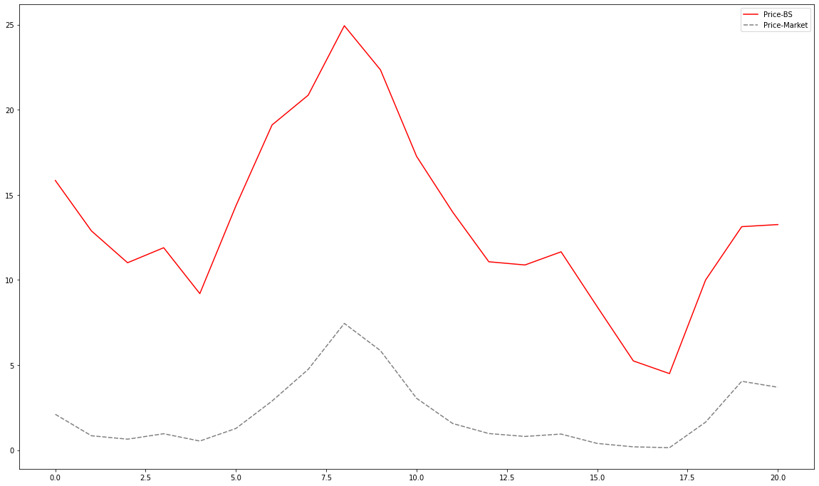
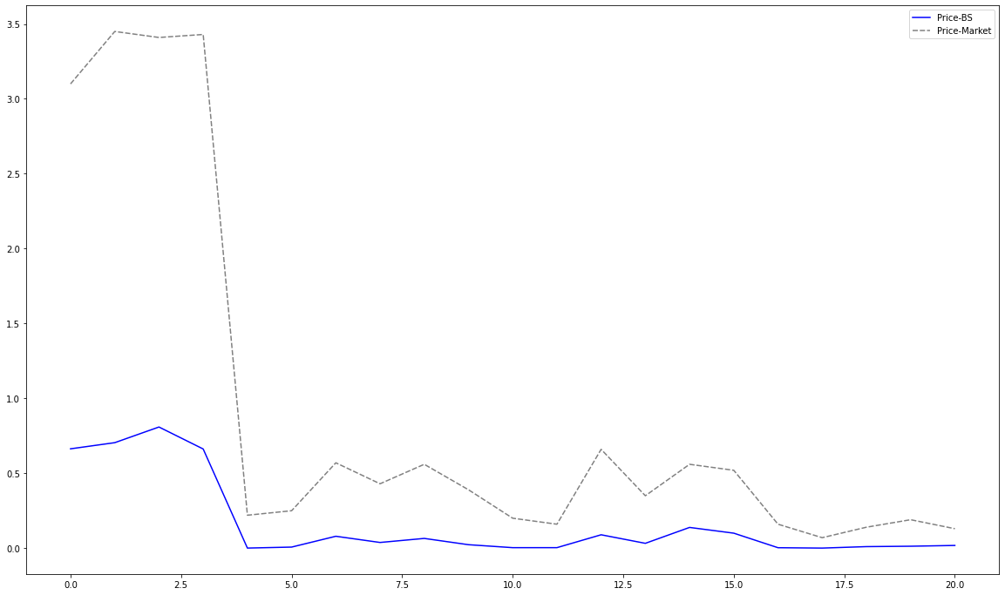
Stock and Options Trends
Graphs on the left compare the stock prices and options prices of two media companies in S&P 500 – Disney (DIS) and Netflix (NFLX)
These companies have comparable market capital; however, stock prices and options prices do not move in tandem along the same timelines
Based on observation of historical values, NFLX’s stock and options prices appear to be more volatile compared to DIS.
Stock prices 2021-22
Options Prices (Mat: Dec ‘22)
Black-Scholes
The two graphs compare the Black-Scholes model output of fair prices of call options vs the actual call values of the stock for DIS and NFLX
Interestingly, the Black Scholes model of the NFLX, which appeared to be the more volatile stock has captured the trends in price movement, while the model prices on DIS are closer to the actual market values
The graphs highlight the main limitation of Black-Scholes – assuming constant volatility over the option’s life and constant risk-free interest rates
NFLX: Black Scholes vs Market Price
DIS: Black Scholes vs Market Price

